Slide 1





Speeding Up Image Processing with GPU Programming
Amanda Polarolo
Blur Grayscale Edge Detect Negative

Slide 2

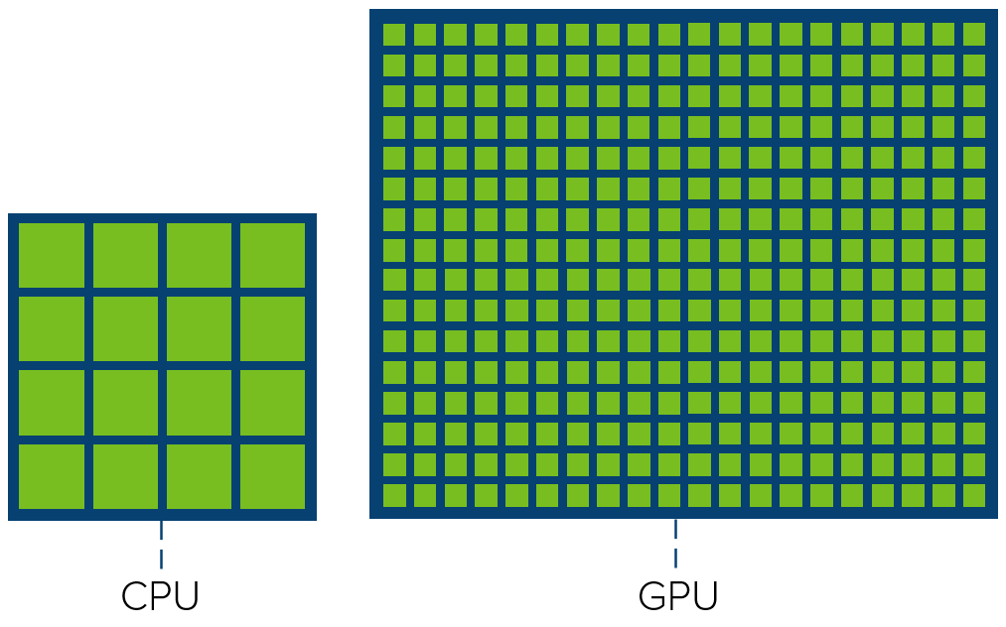
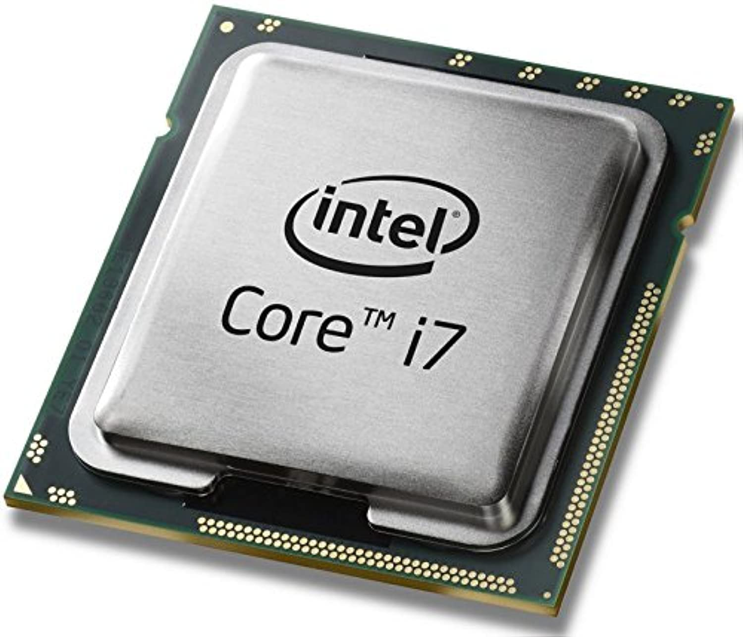
Introduction to CPUs
CPU is great when working with small datasets
4-16 cores
Issues when processing large images and datasets

Slide 3
Results of CPU
225x225 pixels: 50,625 pixels
4000x2667 pixels: 10,668,000 pixels
Algorithm | Runtime (CPU) (seconds)
Negative | 0.3388 | 0.2246 | 0.2838
Grayscale | 0.3305 | 0.2512 | 0.3284
Edge Detect | 1.9387 | 1.8232 | 1.8985
Blur | 1.7896 | 2.1079 | 1.7002
Algorithm | Runtime (CPU) (seconds)
Negative | 51.6895 | 51.0431 | 51.3210
Grayscale | 33.2942 | 33.4642 | 33.8441
Edge Detect | 518.5088 | 514.2150 | 518.0150
Blur | 605.6648 | 316.8841 | 248.9846

Slide 4

Proposal to Fix Issue
GPUs have thousands of cores rather than CPUs 4-16 cores
Parallel computing
Rather than having a few efficient and fast “workers”, GPU uses thousands of smaller workers that work at the same time together as opposed to independently working fast

Slide 5



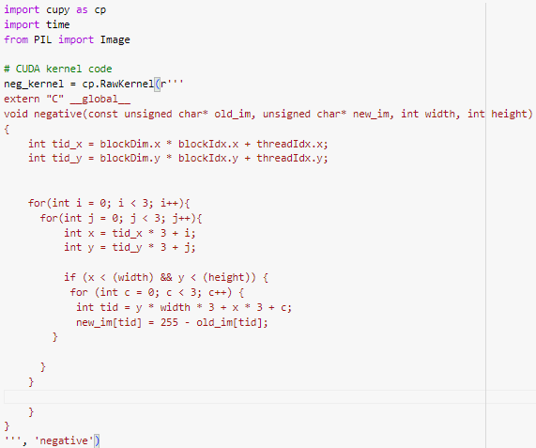
My Process
Google Colab IDE
CuPy 3d array: (x, y, RGB)
Kernel code in C: NVIDIA CUDA
2d kernel assigning pixels to GPU threads

Slide 6
My results compared to CPU
Small Image 225x225
Large Image 4000x2667
Algorithm | Runtime (CPU) (seconds)
Negative | 0.3388 | 0.2246 | 0.2838
Grayscale | 0.3305 | 0.2512 | 0.3284
Edge Detect | 1.9387 | 1.8232 | 1.8985
Blur | 1.7896 | 2.1079 | 1.7002
Algorithm | Runtime (GPU) (seconds)
Negative | 0.00007 | 0.00006 | 0.00008
Grayscale | 0.00005 | 0.00006 | 0.00007
Edge Detect | 0.00009 | 0.00006 | 0.00006
Blur | 0.00006 | 0.00005 | 0.00005
Algorithm | AVG CPU AVG GPU CPU/GPU
Negative | 0.29240 | 0.00005 | 5,613.435
Grayscale | 0.30338 | 0.00007 | 4,546.484
Edge Detect | 1.88682 | 0.00006 | 30,125.588
Blur | 1.86592 | 0.00007 | 25,447.496
Algorithm | AVG CPU AVG GPU CPU/GPU
Negative | 51.35122 | 0.00007 | 738,459.110
Grayscale | 33.53417 | 0.00006 | 551,521.606
Edge Detect | 516.91295 | 0.00007 | 7414,907.088
Blur | 390.51116 | 0.00005 | 7,178,821.790

Slide 7
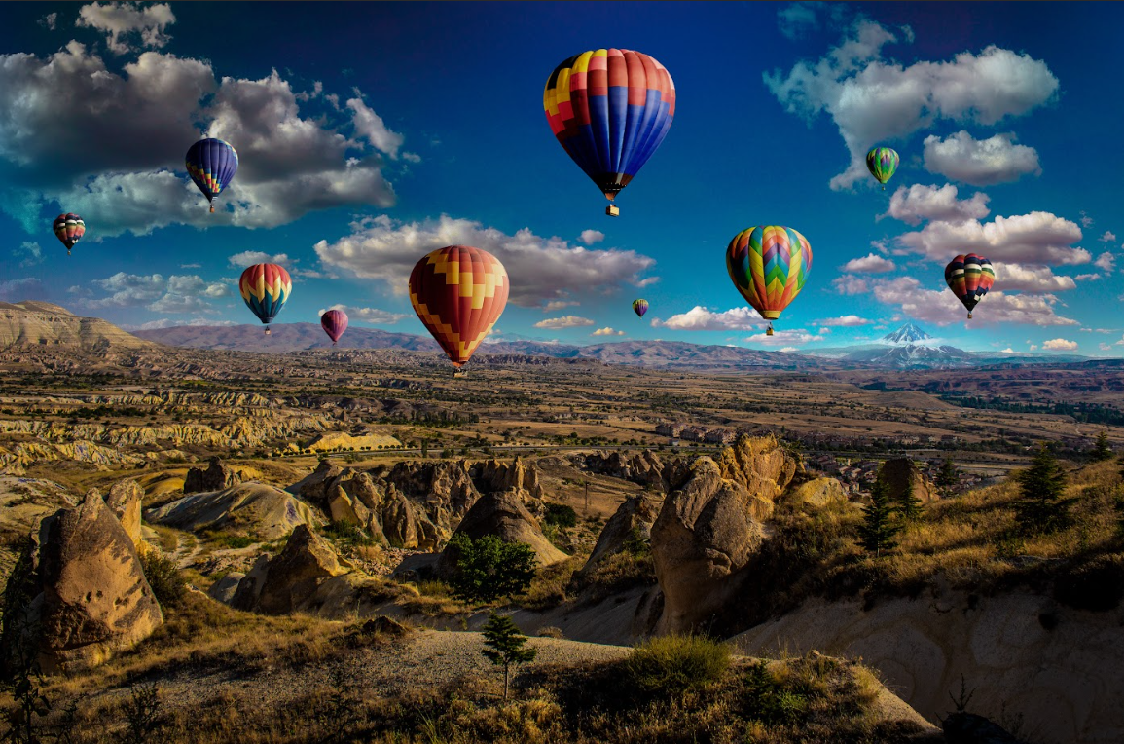
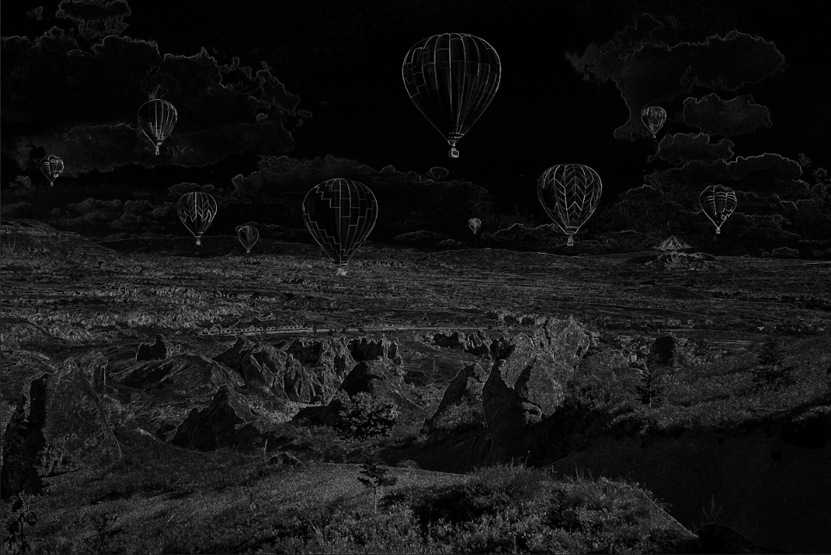
Why people should care
Image Processing
Processing Large Datasets
Protect the CPU from overworking
Getting the most of your GPU and CPU

Slide 8

Speeding Up Image Processing with GPU
Algorithm | CPU Time / GPU Time
Negative | 5,613.435
Grayscale | 4,546.484
Edge Detect | 30,125.588
Blur | 25,447.496
Algorithm | CPU Time / GPU Time
Negative | 738,459.110
Grayscale | 551,521.606
Edge Detect | 7,414,907.088
Blur | 7,178,821.790
Contact info:
polaroal@clarkson.edu
(315) 705-7476
ACKNOWLEDGMENT
This work is supported by National Science Foundation under Grant Nos, OAC-2244049.

